Slide 1
Data distributions in ecology beyond Gaussian
Shivam Shrotriya

Slide 2
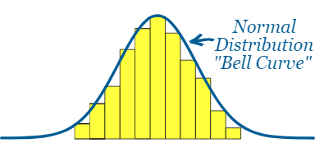
Normal Distribution curve and its features

Slide 3
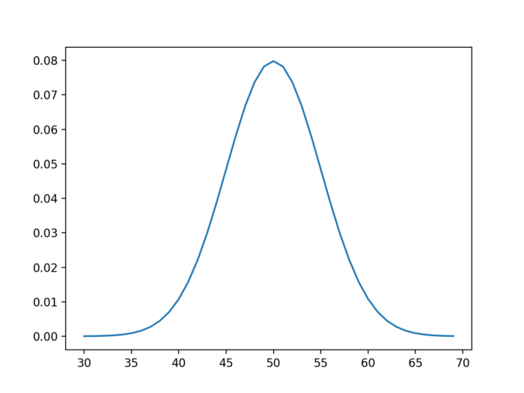
Normal Distribution curve and its features
Probability density function

Slide 4
Normal Distribution curve and its features
Probability density function

Slide 5
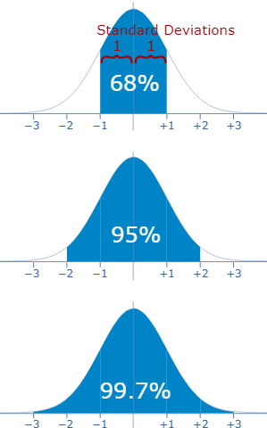
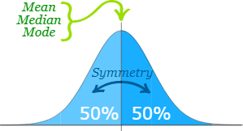
Normal Distribution curve and its features

Slide 6
Normal Distribution curve and its features
Examples
Data analyses

Slide 7
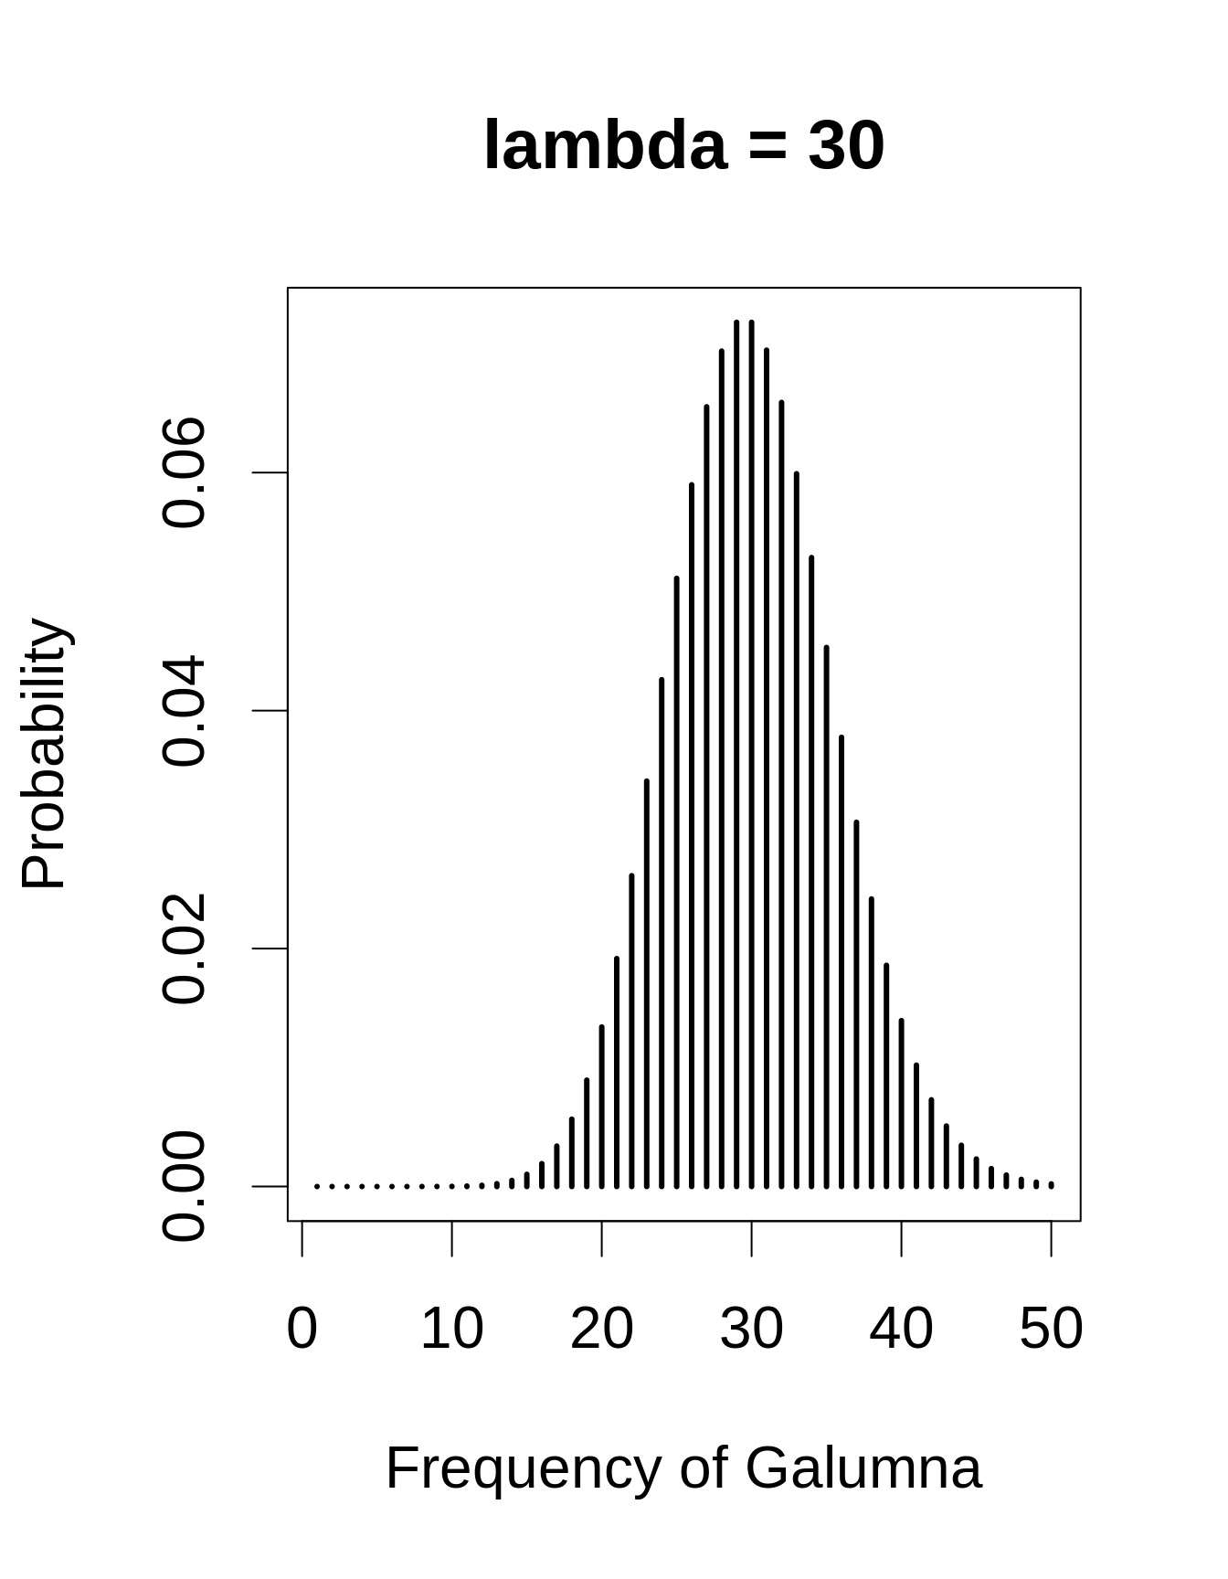
What happens if the data is counts?
No. of bird calls per minute

Slide 8
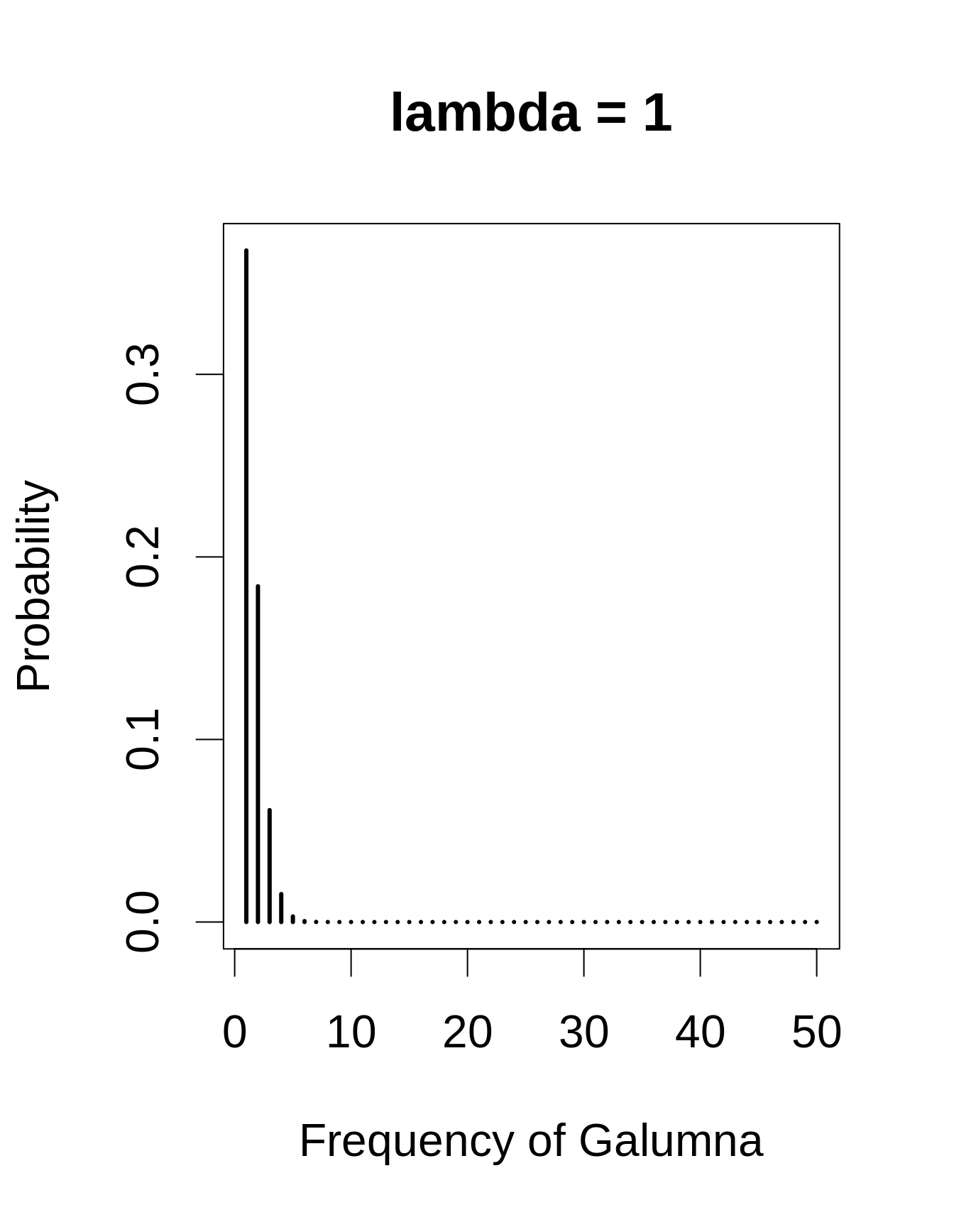
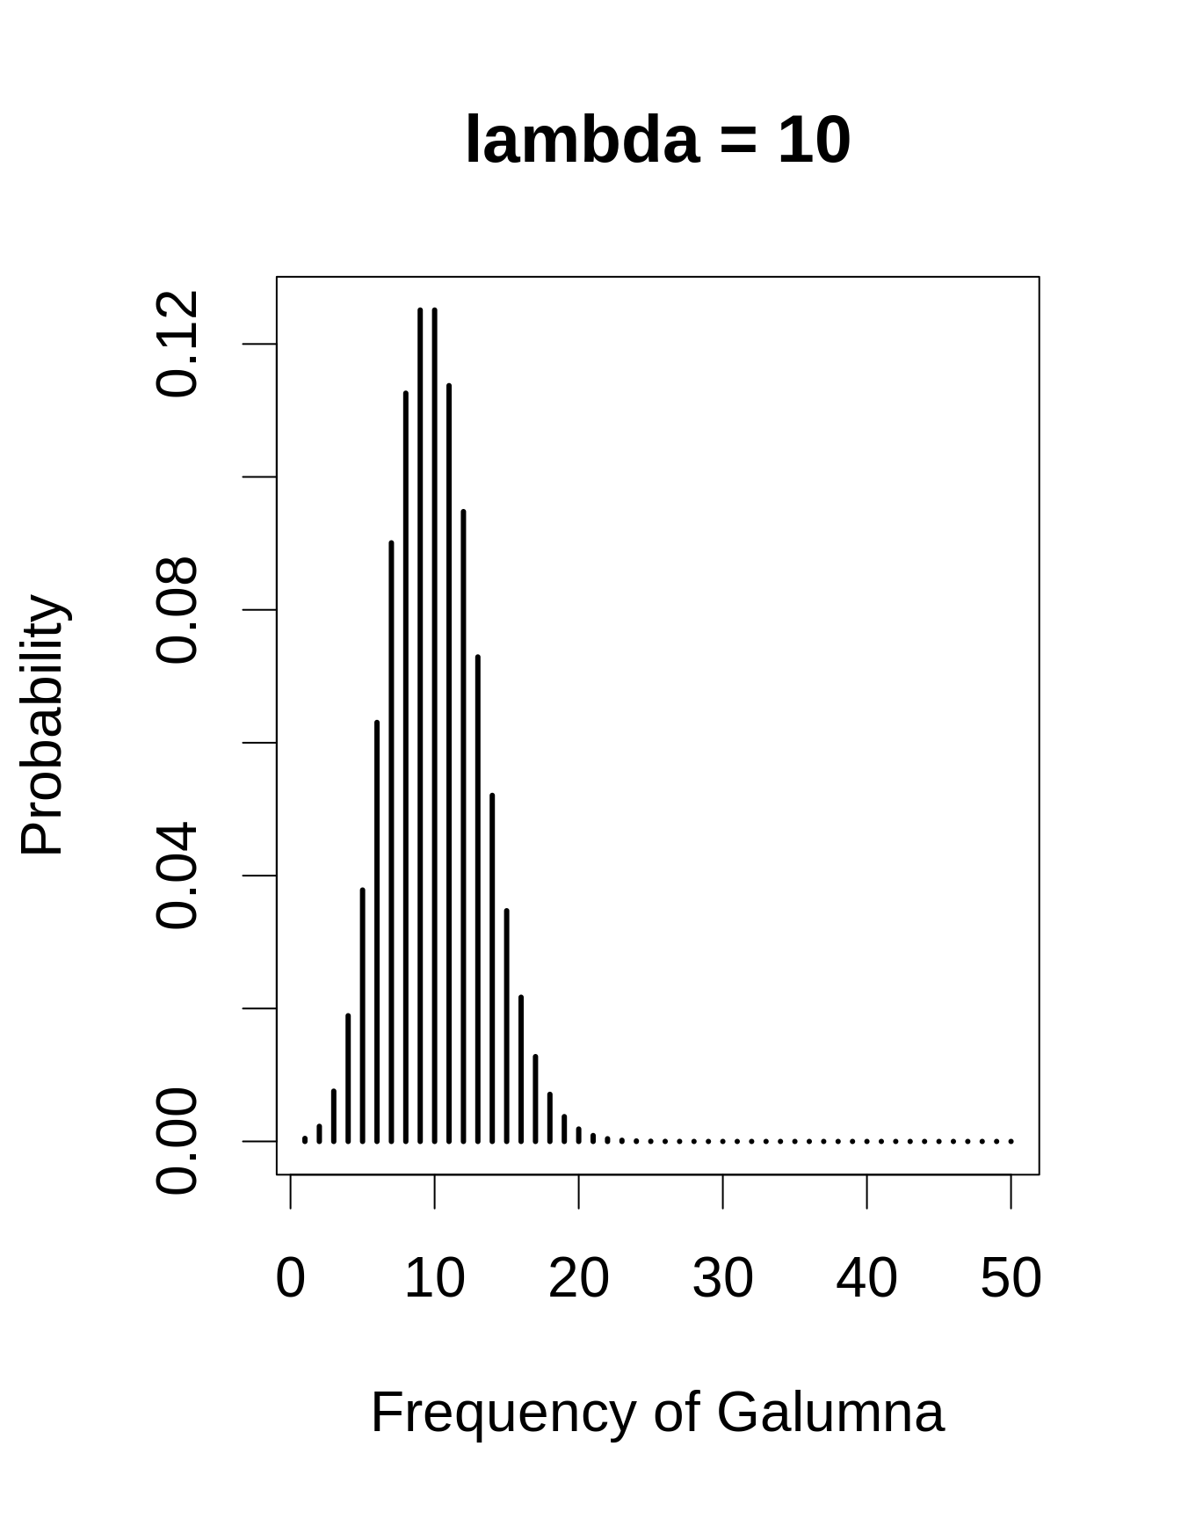
Poisson Distribution and key features
Data values are always integers
The range of a Poisson distribution is always strictly positive
λ value is somewhat similar to mean, but not exactly. It defines mean and variance together
The variance increases with the mean
No. of bird calls per minute

Slide 9
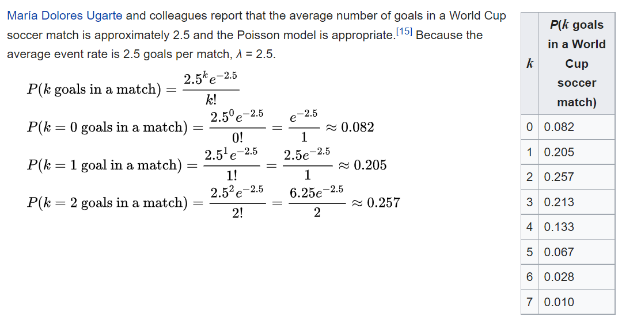
Poisson Distribution and key features

Slide 10
Poisson Distribution and key features
Examples
Abundances, Sapling counts, Reproductive success etc

Slide 11
Poisson Distribution and key features
Data analyses
Tests of difference
Conditional mean test (C-test)
test based on estimated p-values (E-test)
Large sample z-test (Mathew 2010)
Poisson regression, Poisson point-process modeling

Slide 12
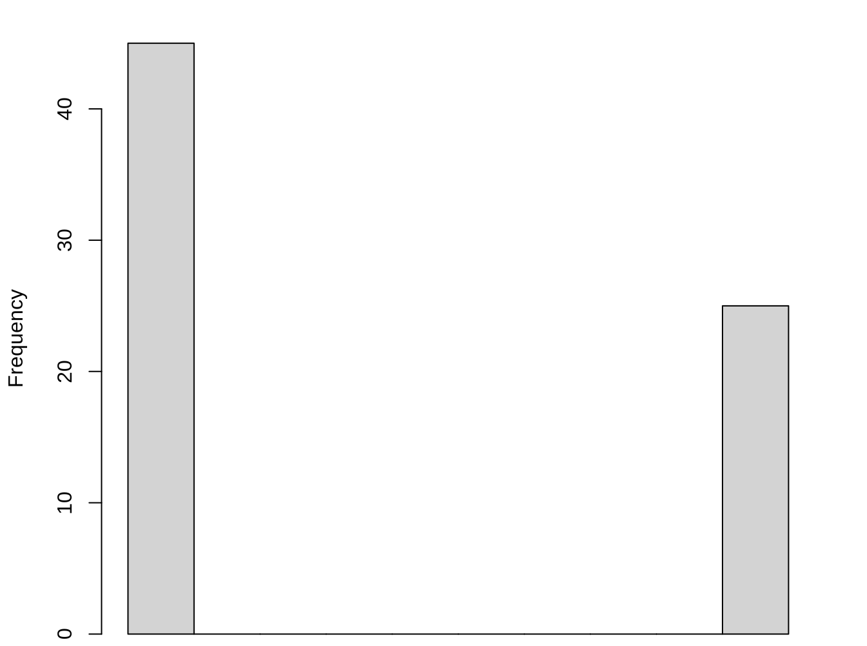
What happens if there are only two possibilities of the count?
No call Call
If the bird called or not

Slide 13
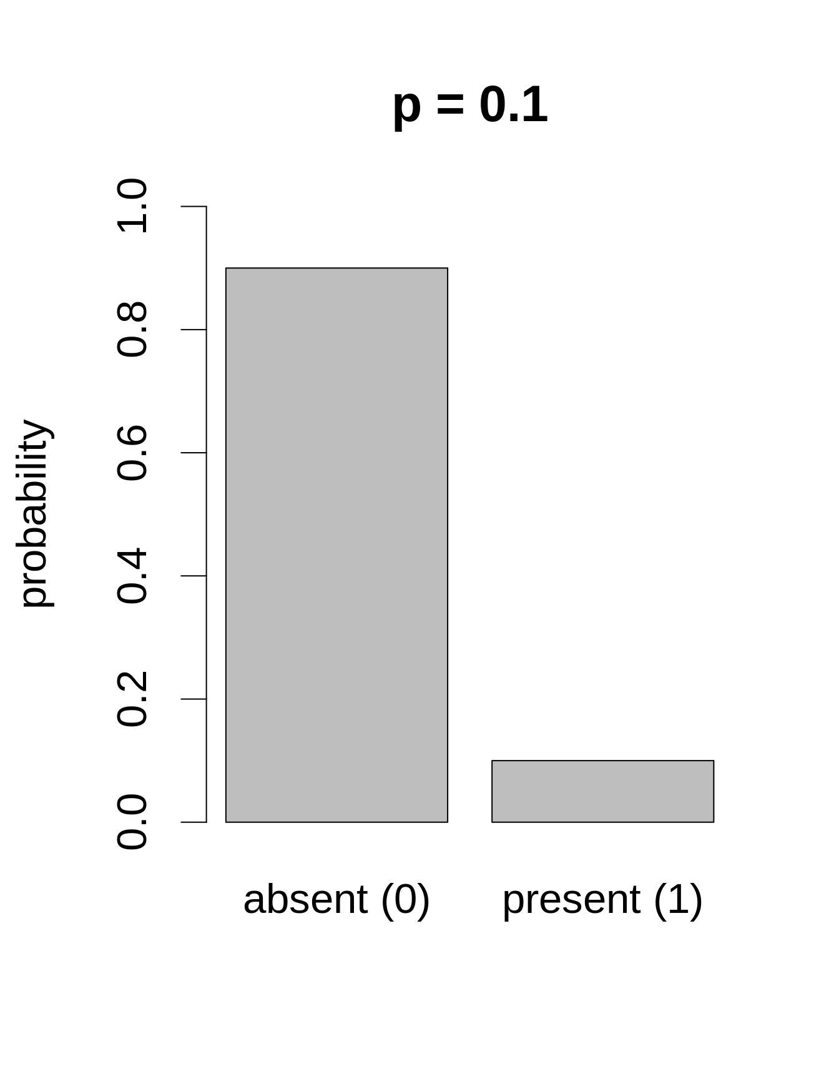
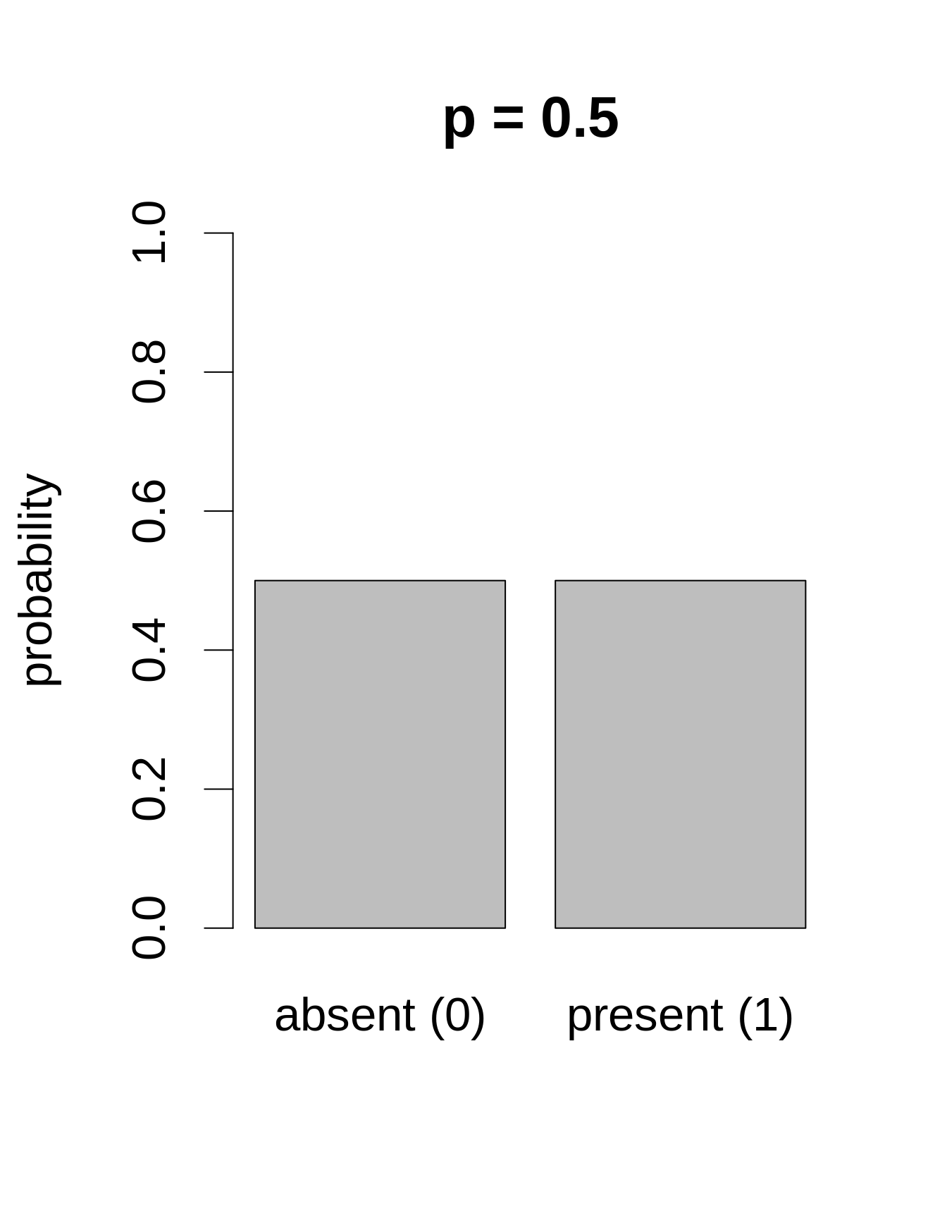
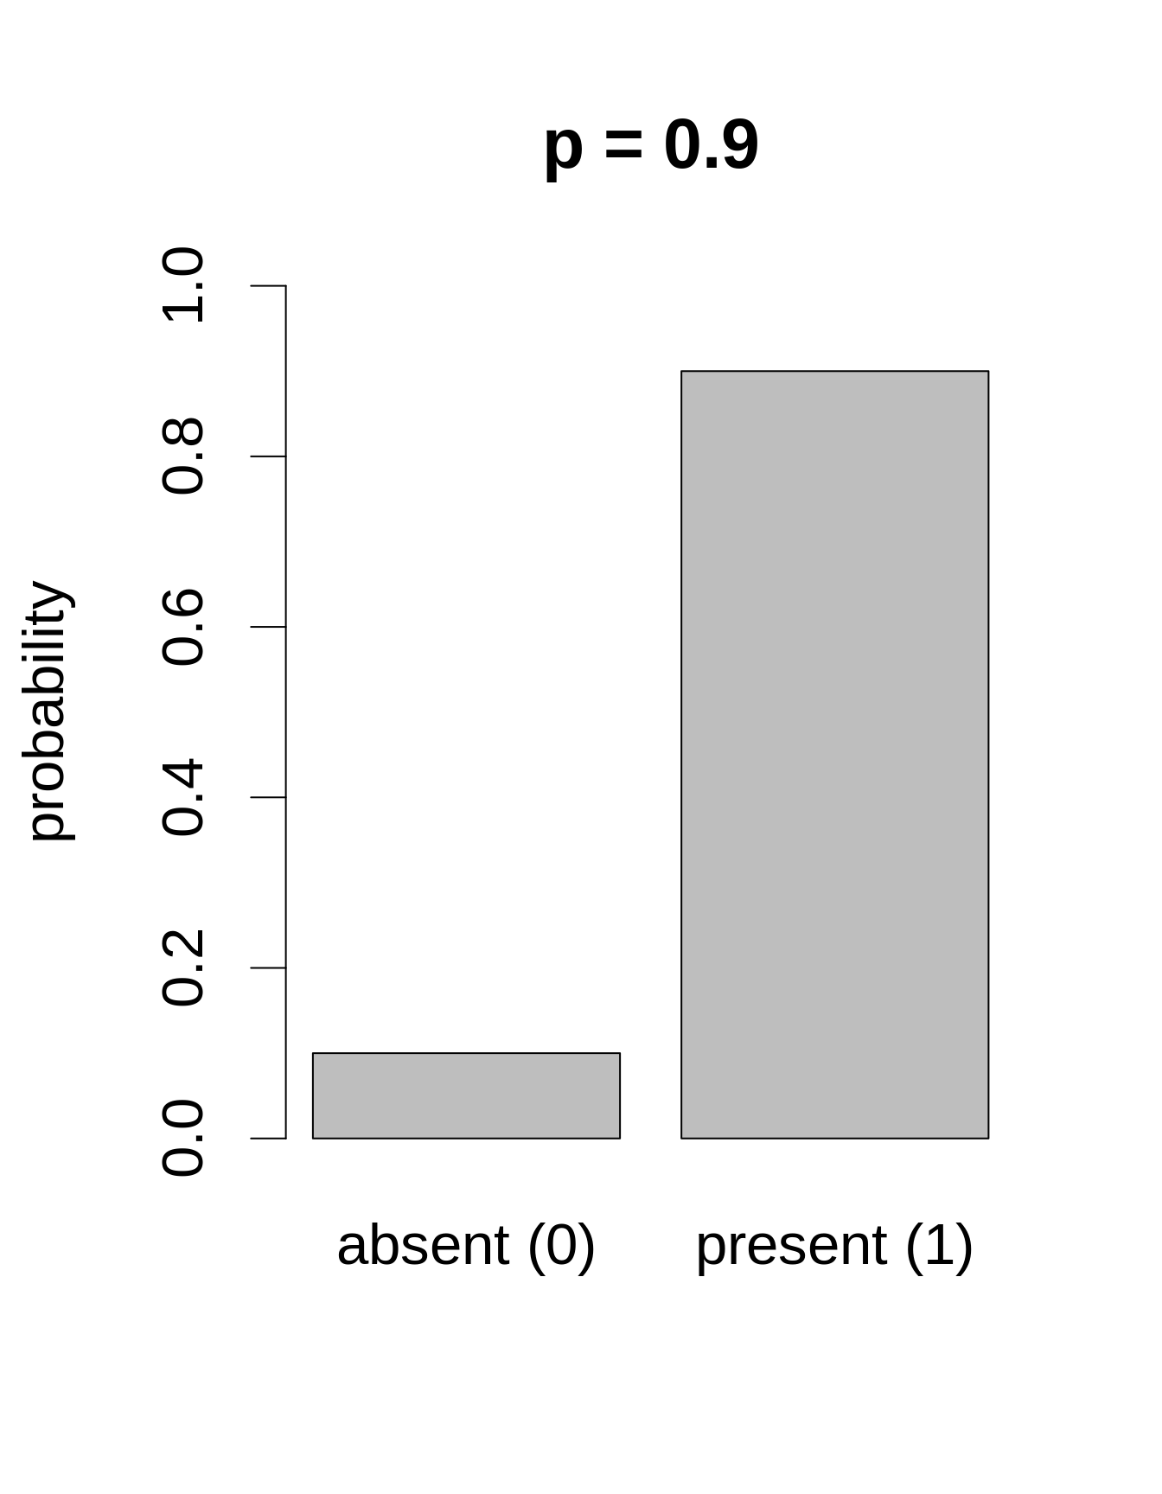
Bernoulli Distribution
If the bird called or not
Single parameter is p

Slide 14
Multiple trials of presence/absence
No of sites/samples

Slide 15
Binomial Distribution
Key parameters are p and n
right-skewed at low p-values but left-skewed at high p-values
upper limit to its range, n (think of Poisson)
λ value is somewhat similar to mean, but not exactly. It defines mean and variance together
The variance increases with the mean

Slide 16
Binomial Distribution
Examples
Species presence-absence data, Yes/No questionnaires, Male/Female ratio

Slide 17
Binomial Distribution
Data analyses
Tests of difference
Chi-squared test if your sample is large
Fisher's exact test if your sample is small
Z-test for independent samples
Logistic regression

Slide 18
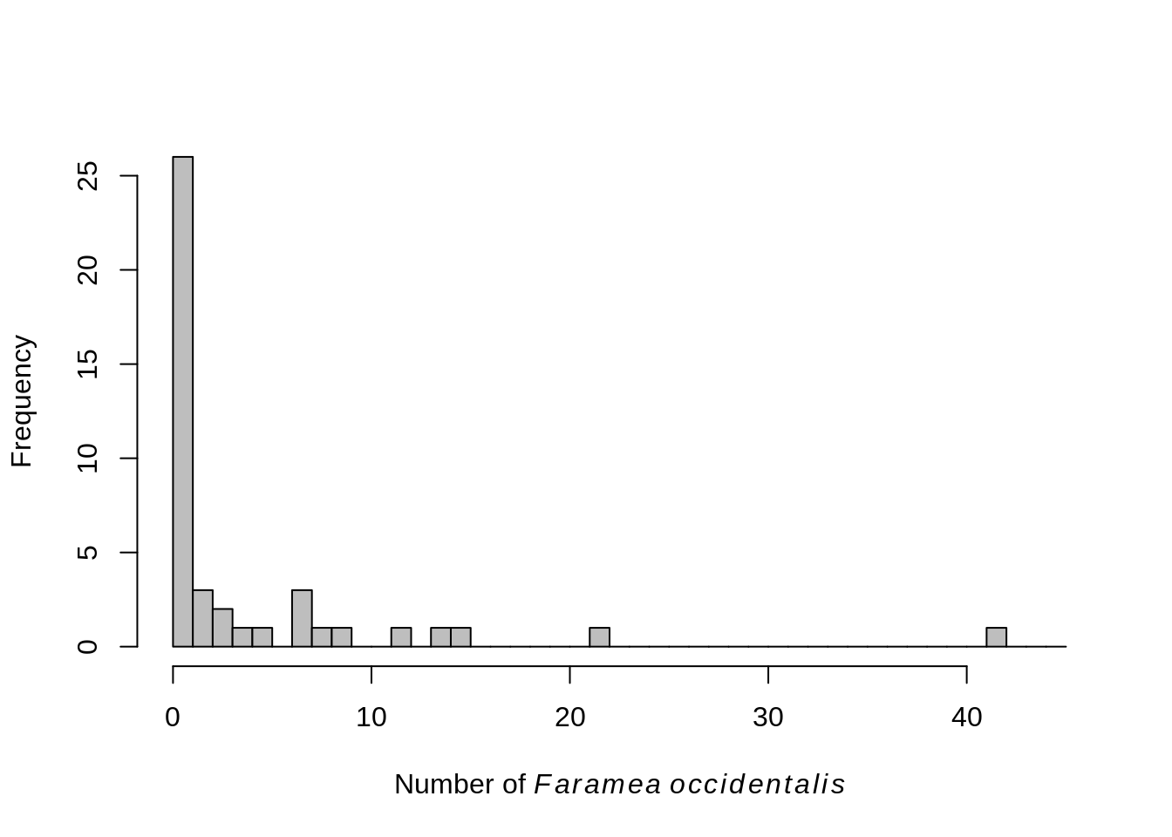
Which distribution will you use to model this data?
Number of trees in a plot

Slide 19
How are these data similar or different?
Variance, or dispersion of the data…
Number of trees in a plot
Number of trees in a plot

Slide 20
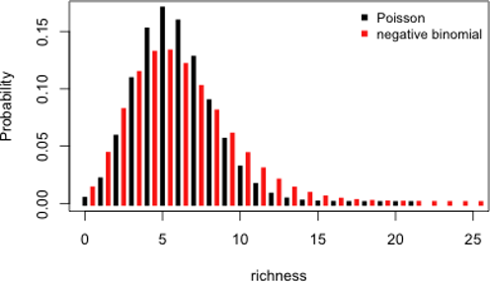
Negative Binomial Distribution
Data values are always integers
The range of the distribution is always strictly positive
Key parameters are p (something like mean) and k (denoting variance)
Origin from Bernoulli trails modelled as probability of the number of failures before event
Used mainly as over dispersion correction in Poisson distributions (NB regressions)
Binomial probability mass function

Slide 21
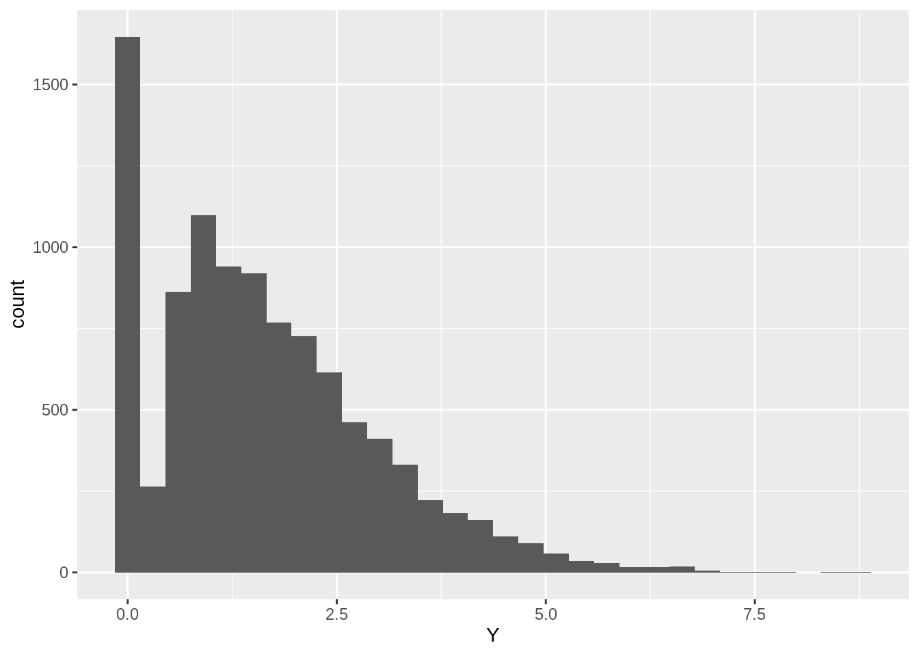
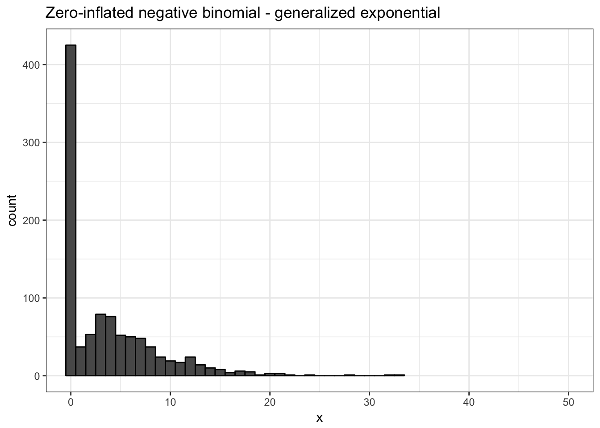
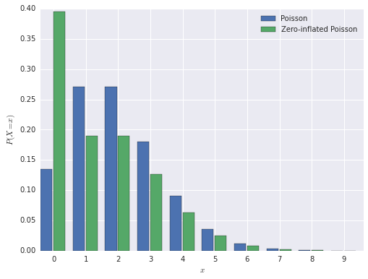
Zero-inflation

Slide 22
Zero-inflation
Tweedie distribution
Zero-inflated Negative Binomial
Zero-inflated Poisson distribution

Slide 23
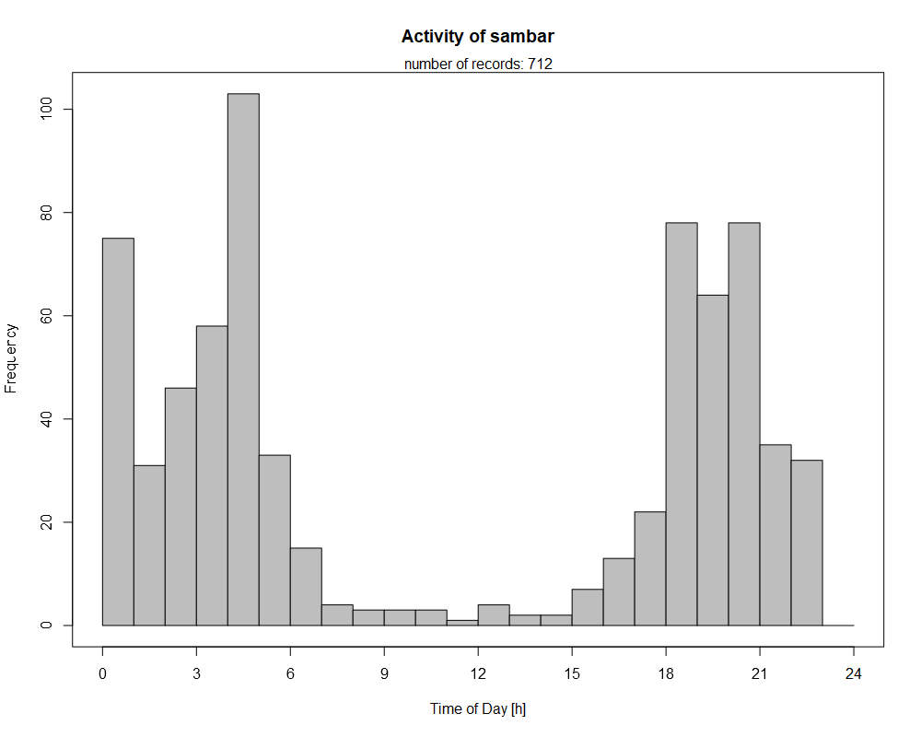
Let’s look at some special types of data
Encounters of a mountain bird on different aspects

Slide 24
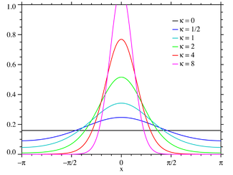
von Mises or Circular Normal Distribution
Key parameters μ, and k
μ is analogous to mean, and 1/k is quite like variance
Data analyses
-Circular ANOVA, circular GLM

Slide 25
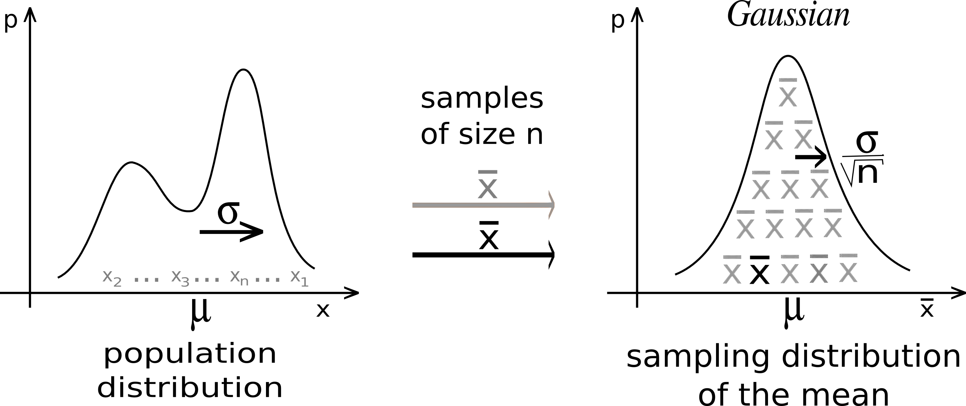
Central limit theorem

Slide 26
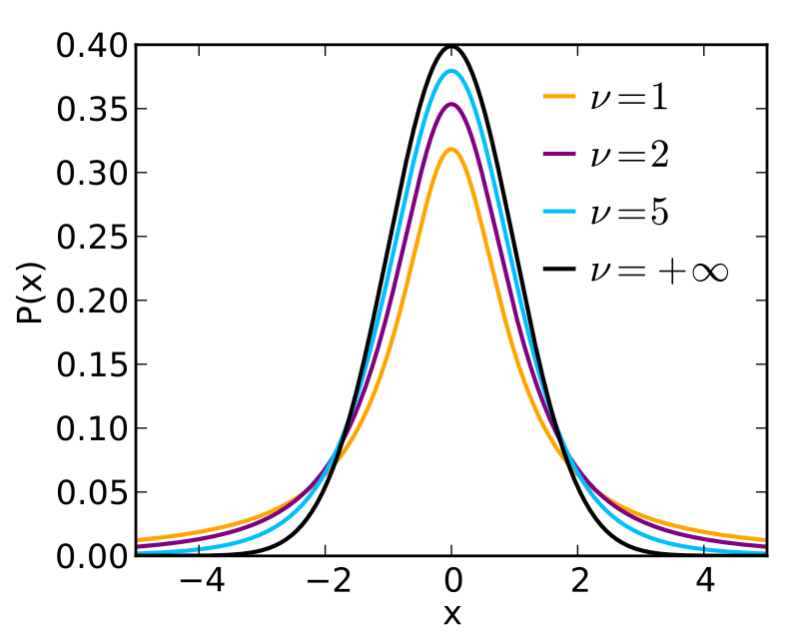
Student’s t-distribution
William Sealy Gosset (aka Student)

Slide 27
Other notable probability distributions
Log-normal distribution (Proportions and percentage data)
Gamma probability distribution (Shape and scale based; also useful for proportion and percentage data)
Exponential and negative exponential (Survival data)
Chi- square distribution
Beta distribution (As priors for binomial distribution in Bayesian analyses, e.g. Occupancy modelling)

